Slide 1
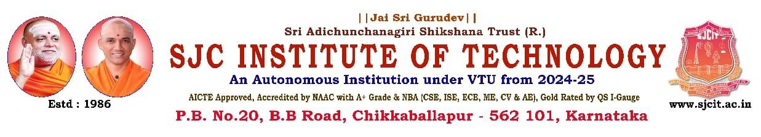
“Enhancing images captured in low-light conditions often suffer from poor visibility and noise.”
PRESENTED BY
1 Ajaganna 1SJ22CS006
2 Akash 1SJ22CS007
3 Akshay M S 1SJ22CS008
4 Bhargav V 1SJ22CS024
UNDER THE GUIDANCE OF
Dr Seshaiah M
Associate professor, Department of CSE

Slide 2
CONTENTS
Problem Statement/Title
Abstract
Introduction
Literature Survey (comparison with existing system)
SRS (System requirements specification)
Architecture/System Design (high level and detailed design)
Summarize the methodologies/Algorithms implemented
Partial results obtained
Project Plan 3.0

Slide 3
PROBLEM STATEMENT
Enhancing Low-Light Images: A Hybrid Deep Learning Approach
Images captured in low-light conditions often suffer from poor visibility and excessive noise. This project presents a novel algorithm designed to overcome these challenges, significantly improving image quality while preserving crucial details.

Slide 4
ABSTRACT
Low-light conditions significantly degrade image quality, affecting applications such as surveillance, photography, and autonomous systems. To address this challenge, this project presents a hybrid solution that combines DEDUNet, a deep learning model for brightness enhancement and noise reduction, with advanced image processing techniques such as gamma correction, CLAHE, selective enhancement, and color grading. Furthermore, a web-based interactive interface has been developed, providing advanced color controls, real-time quality metrics (PSNR, SSIM, and Enhancement Score), and user feedback through a 5-star rating system.

Slide 5
INTRODUCTION
Low-light images often suffer from poor brightness, noise, and loss of details. Traditional methods such as histogram equalization, CLAHE, and gamma correction improve brightness but usually amplify noise. Deep learning approaches like DEDUNet overcome this by enhancing brightness and reducing noise simultaneously. Our system combines both approaches to achieve robust and high-quality image enhancement.
Deep Learning (DEDUNet) for robust enhancement.
2. Classical Processing for fine adjustments and professional-grade controls.
3. Interactive Web App for user-driven evaluation.

Slide 6
Literature Survey
Sl. No. | Title & Year of Publication | Methodology Used | Limitations
1 | Low-Light Image Enhancement by Principal Component Analysis (2018) | PCA-based enhancement using feature projection to improve brightness and contrast | Lacks adaptive learning and fails in preserving texture under complex lighting
2 | Single-Stage Unsupervised Denoising Low-Illumination Enhancement using Swin Transformer (2023) | Swin Transformer-based unsupervised model for enhancement and denoising without paired training data | High computational cost, limiting real-time edge deployment
3 | Cross-Image Disentanglement for Low-Light Enhancement in Real World (2022) | Disentangling illumination and content features via unpaired learning | Requires complex training and fine-tuning for effective generalization
4 | DEDU: Dual-Enhancing Dense-UNet for Lowlight Image Enhancement and Denoise (2024) | Dual-pathway Dense UNet separating structure and detail features for robust enhancement | Higher model complexity and increased training time

Slide 7
Literature Survey
Sl. No. | Title & Year of Publication | Methodology Used | Limitations
5 | DLDiff: Image Detail-Guided Latent Diffusion Model for Low-Light Image Enhancement (2023) | Uses latent diffusion guided by image details to enhance low-light images progressively | Computationally expensive; slower inference makes it less suitable for real-time use
6 | Ghost Imaging in the Dark: A Multi-Illumination Estimation Network for Low-Light Image Enhancement (2023) | Employs ghost imaging principles and multiple illumination estimations to enhance scene visibility | May introduce latency and perform poorly in extremely low-light or noisy conditions
7 | Self-Supervision via Controlled Transformation and Unpaired Self-Conditioning for Low-Light Image Enhancement (2023) | Trains the model without paired data using controlled transformations and self-conditioning | Might be less effective in highly diverse real-world settings without additional fine-tuning
8 | LRT: An Efficient Low-Light Restoration Transformer for Dark Light Field Images (2023) | Applies Transformer-based restoration specifically for dark light field images using attention mechanisms | Demands high GPU memory and compute power, making it impractical for deployment on low-resource devices

Slide 8
SRS (System Requirements Specification)
Functional Requirements:
Upload image and apply enhancement (DEDUNet + traditional).
Provide color controls (brightness, contrast, saturation, hue, temperature, shadows/highlights).
Show real-time quality metrics (PSNR, SSIM, enhancement score, processing time).
Collect user ratings via 5-star feedback.
Non-Functional Requirements:
Performance: <1s processing per image.
Usability: Web-based interface with sliders and previews.
Compatibility: Supports multiple image formats (PNG, JPG, BMP, TIFF).
Software Requirements:
Python, PyTorch, OpenCV, Flask, NumPy, PIL, skimage.
Hardware Requirements:
Dell laptop with NVIDIA GeForce GTX 1650 GPU (4GB VRAM) and on Google Colab with Tesla T4 GPU
Minimum 8GB RAM, 2.5 GHz CPU.

Slide 9

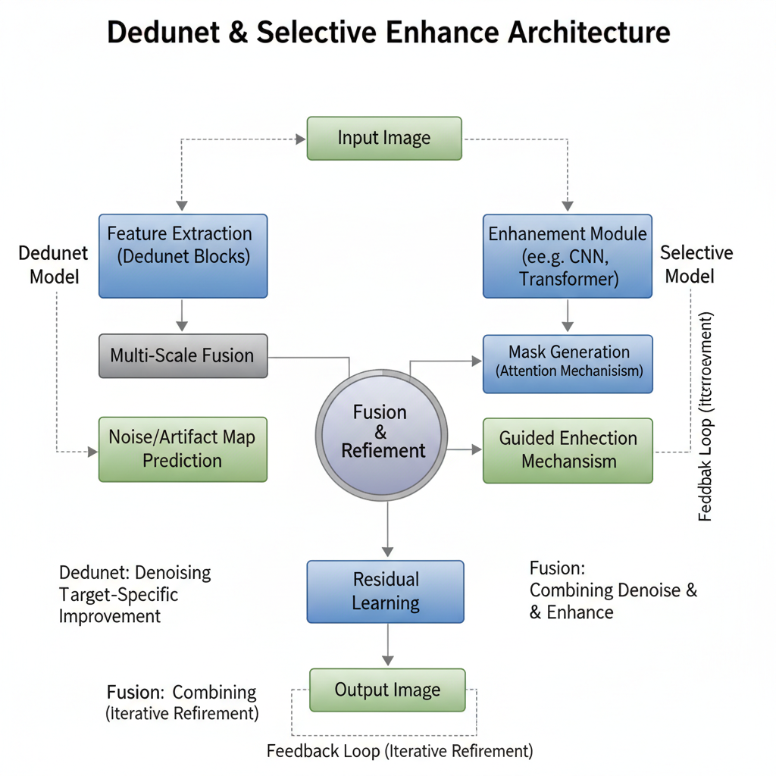
Architecture / System Design
High-Level Design:
Input Module → Upload image.
Processing Module:
Traditional enhancement (CLAHE, Gamma, Selective Enhancement).
DEDUNet deep learning model for low-light enhancement.
Post-processing (denoising, sharpening, color grading).
Quality Evaluation Module → PSNR, SSIM, enhancement score.
User Interface (Web App) → Sliders, filters, beauty enhancement, star rating.
Output Module → Enhanced image + metrics.
Detailed Design:
DEDUNet:
Encoder with Dense Blocks + CSP + DFC Attention.
Bottleneck with Dual Enhancement Block.
Decoder with skip connections + enhancement blocks.
Web App:
Flask backend with enhancement pipeline (web_app.py).
Frontend: HTML templates + real-time preview.
Input Module
Processing Module
Quality Evaluation
User Interface

Slide 10
Methodologies / Algorithms Implemented
Deep Learning: DEDUNet (brightness enhancement + noise reduction).
Classical Enhancement: CLAHE, Gamma Correction, Histogram Equalization.
Advanced Denoising: NLM, Bilateral, Gaussian, Median filters.
Color Adjustments: Brightness, Contrast, Saturation, Hue, Temperature, Shadows, Highlights.
Quality Evaluation: PSNR, SSIM, Enhancement Score, Processing Time.
Feedback: 5-star interactive rating system.

Slide 11
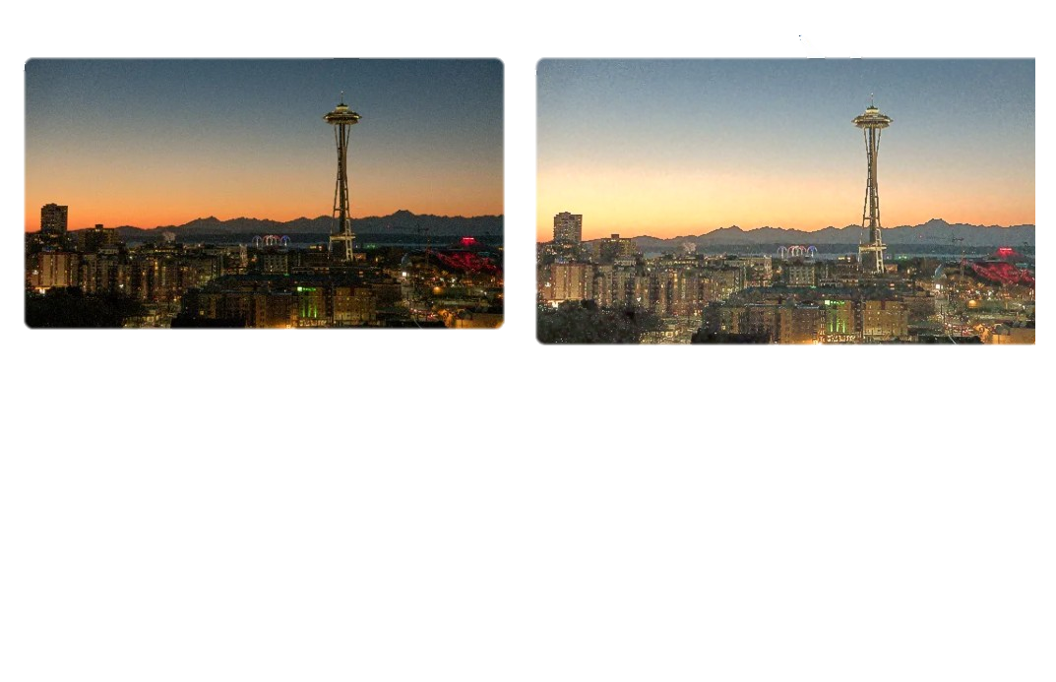
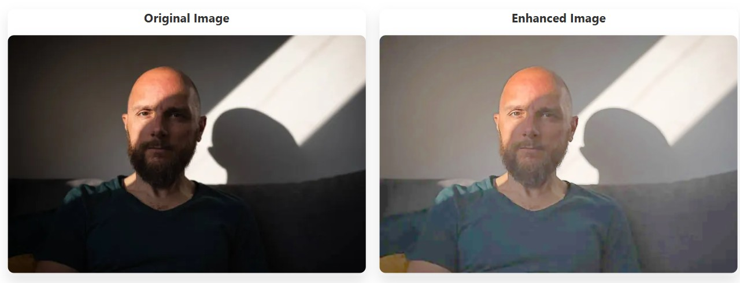
Partial Results Obtained
Sample low-light image enhanced → brighter, less noisy, improved details (see below examples).
Quality Metrics Example:
PSNR ↑ from ~18 dB → ~32 dB.
SSIM ↑ from ~0.62 → ~0.91.
Enhancement Score ~85%.
Real-time processing under 1s per image
(on GPU).
User study: Higher satisfaction with
advanced color grading + feedback loop.

Slide 12
PLAN OF EXECUTION 3.0
Week 1: Implemented DEDUNet model and tested on sample low-light images. Week 2: Integrated classical methods (Gamma, CLAHE) and compared outputs. Week 3: Developed basic Flask web interface for image upload and processing. Week 4: Added advanced color adjustments and partial quality metrics (PSNR, SSIM).
Week 5: Optimized DEDUNet with dual enhancement blocks for better results. Week 6: Completed integration of real-time quality metrics and enhancement score. Week 7: Developed full 5-star rating system with feedback messages in the web app. Week 8: Final testing, documentation, and preparation of results for submission.

Slide 13
THANK YOU

